Slide 1
Developing a Basic Snake Game in C: A Step-by- Step Approach

Slide 2

Introduction to Snake Game
is a classic arcade game that involves controlling a snake to consume food while avoiding collisions. In this presentation, we will explore
a
to developing a basic version of this game in
. Let's dive into the essential components and
coding techniques required.

Slide 3





To begin, we need to set up our
. This includes installing a
and a suitable . We will also discuss the necessary libraries for handling graphics and input. Proper setup is crucial for smooth and debugging.

Slide 4
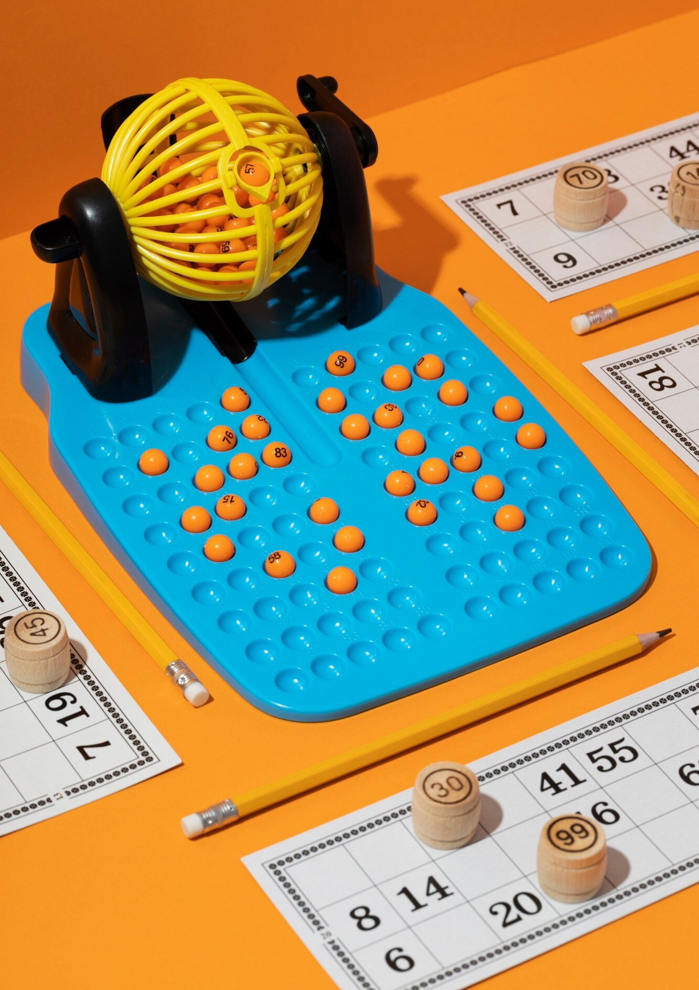

Next, we will focus on implementing the core
. This includes defining the , food generation, and collision detection. We will write functions to handle these aspects, ensuring that the game runs smoothly and responds to player inputs effectively.

Slide 5


In conclusion, we have outlined the fundamental steps to develop a basic . While this presentation covered the essentials, there is ample opportunity for
such as adding levels, scores, and improved graphics. Continuous learning and experimentation will lead to a more robust game.

Slide 6

Thanks!
DO YOU HAVE ANY QUESTIONS?
youremail@freepik.com
+34 654 321 432
yourwebsite.com

